Slide 1

Banking Management
System in C
PRESENTED BY
PSD TEAM

Slide 2

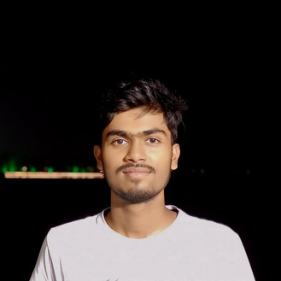

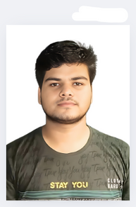
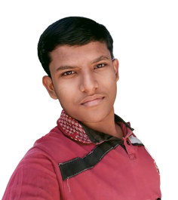
Pritam Sahoo
Our Team
Suman Maji
Debajyoti Roy
Sudipta Mondal

Slide 3


Motivations
Behind the Project
Banking is a critical pillar of our economy, yet many traditional systems are complex and outdated. We wanted to build a digital banking management system to simplify user interactions and improve security. This project aims to make financial management more efficient and accessible for users.

Slide 4
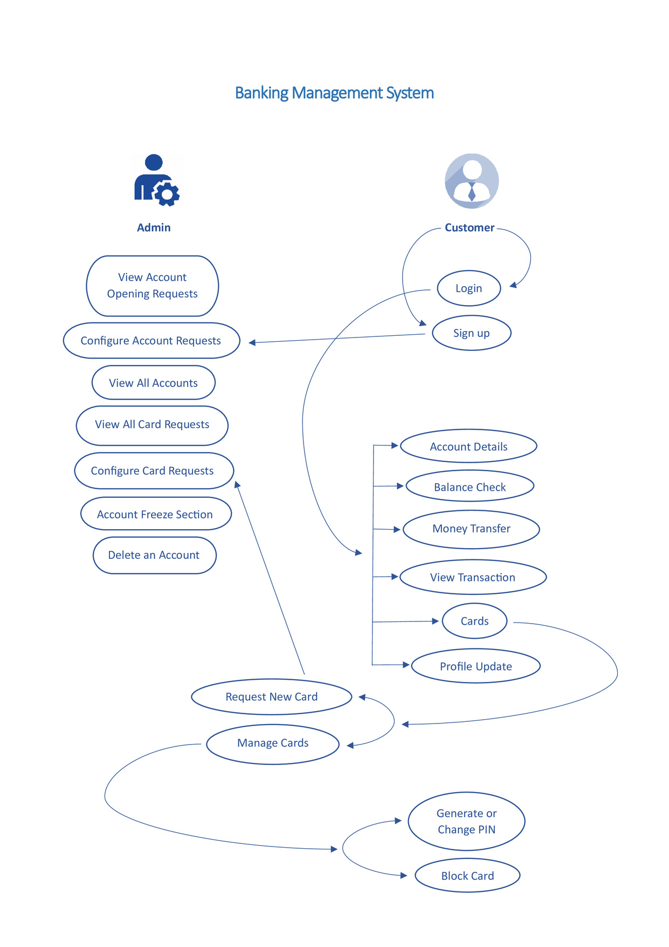
SYSTEM DESIGN AND ARCHITECTURE

Slide 5

Enhancing User Experience and Security
Our Project Objectives
To make banking tasks like balance inquiries and transfers straightforward and accessible for all users, while prioritizing robust data security to protect user information.
Promoting Financial Inclusivity
To provide digital banking access to underserved populations, helping bridge the gap and offer essential financial services to those with limited access to physical bank branches.

Slide 6







Goal # 1
Make ease to Transfer money with transaction history
System Features
Goal # 2
Make ease for manageing your cards
Goal # 3
24 X 7 customer support

Slide 7

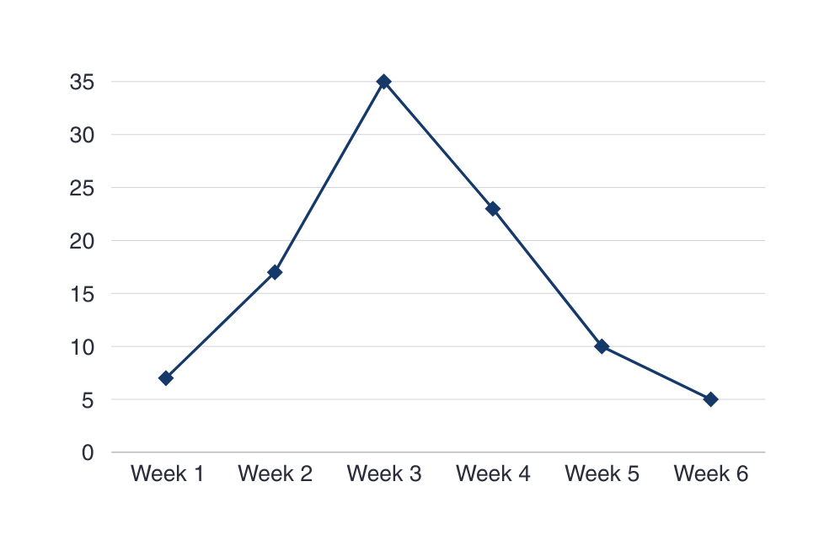
Our Project Progression

Slide 8
Balance Check
Our Offered Services
Money Transfer
Transactions
Card Facilities
Profile Updation

Slide 9
Conclusion
The Banking Management System project successfully simplifies banking by prioritizing user experience, security, and inclusivity. Designed to streamline transactions and enhance accessibility, it empowers users to manage their finances with ease and trust. This system not only brings digital banking within reach of underserved communities but also sets a foundation for secure, scalable, and future-ready banking solutions. Thank you for the opportunity to present, and we are open to any questions!

Slide 10
Thank You !!

